Slide 1
Lecture 15

Slide 2
Repetition
In essence, repetition is already built into the default processing provided by every XSLT processor
  the default processing for an element node involves
    iterating through each of its children and
    processing these nodes appropriately
However, XSLT also provides a construct for explicitly specifying repetition: the xsl:for-each element

Slide 3
the xsl:for-each element
The format of the xsl:for-each element is
  <xsl:for-each select = node-set-expression>
  <!-- Content: (xsl:sort*, template) -->
  </xsl:for-each>
It tells the XSLT processor to
  instantiate the template for every member of the set of nodes identified by the node-set-expression
  optionally, it may also specify that the set of nodes should be sorted before the iteration starts

Slide 4
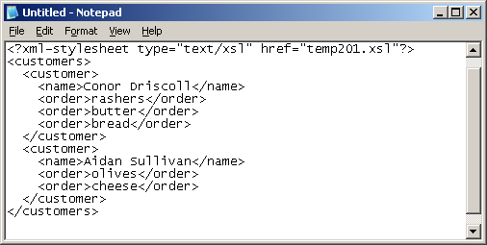
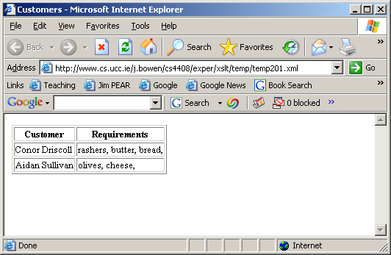
the xsl:for-each element (contd.)
<?xml version="1.0"?>
<xsl:transform version="1.0" xmlns:xsl="http://www.w3.org/1999/XSL/Transform">
<xsl:template match="/">
<html> <head><title>Customers</title></head> <body> <table rules="all">
<thead><tr><th>Customer</th><th>Requirements</th></tr></thead> <tbody>
<xsl:for-each select="customers/customer">
<tr><td> <xsl:apply-templates select="name"/> </td><td>
<xsl:for-each select="order"> <xsl:apply-templates/>, </xsl:for-each>
</td></tr> </xsl:for-each>
</tbody> </table></body></html>
</xsl:template>
</xsl:transform>

Slide 5

comparing xsl:for-each with default processing
<?xml version="1.0"?>
<xsl:transform version="1.0" xmlns:xsl="http://www.w3.org/1999/XSL/Transform">
<xsl:template match="/">
<html> <head><title>Customers</title></head> <body> <table rules="all">
<thead><tr><th>Customer</th><th>Requirements</th></tr></thead> <tbody>
<xsl:apply-templates select="./customers/customer"/>
</tbody></table></body></html>
</xsl:template>
<xsl:template match="order"> <xsl:value-of select="."/>, </xsl:template>
<xsl:template match="customer">
<tr><td><xsl:apply-templates select="name"/> </td><td>
<xsl:apply-templates select="order"/> </td></tr>
</xsl:template>
</xsl:transform>

Slide 6
Sorting
In introducing the xsl:for-each element, it was mentioned that a node set can be sorted before the iterative processing is applied
This is done by including an xsl:sort element as a child of the xsl:for-each element
The format of an xsl:sort element is
  <xsl:sort
  select = string-expression
  lang = { nmtoken }
  data-type = { "text" | "number" | qname-but-not-ncname }
  order = { "ascending" | "descending" }
  case-order = { "upper-first" | "lower-first" } />

Slide 7

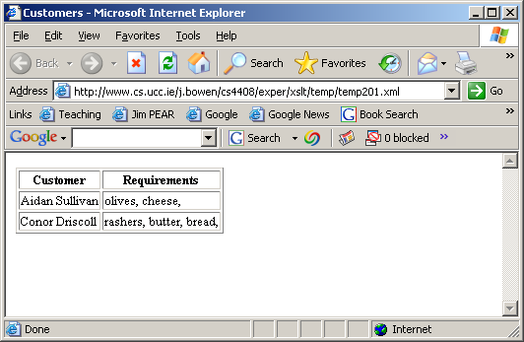
sorting inside the xsl:for-each element: customer names
<?xml version="1.0"?>
<xsl:transform version="1.0" xmlns:xsl="http://www.w3.org/1999/XSL/Transform">
<xsl:template match="/">
<html> <head><title>Customers</title></head> <body> <table rules="all">
<thead><tr><th>Customer</th><th>Requirements</th></tr></thead> <tbody>
<xsl:for-each select="customers/customer">
<xsl:sort select="name"/>
<tr><td> <xsl:apply-templates select="name"/> </td><td>
<xsl:for-each select="order"> <xsl:apply-templates/>, </xsl:for-each>
</td></tr> </xsl:for-each>
</tbody> </table></body></html>
</xsl:template>
</xsl:transform>

Slide 8

sorting inside the xsl:for-each element: orders
<?xml version="1.0"?>
<xsl:transform version="1.0" xmlns:xsl="http://www.w3.org/1999/XSL/Transform">
<xsl:template match="/">
<html> <head><title>Customers</title></head> <body> <table rules="all">
<thead><tr><th>Customer</th><th>Requirements</th></tr></thead> <tbody>
<xsl:for-each select="customers/customer"> <xsl:sort select="name"/>
<tr><td> <xsl:apply-templates select="name"/> </td><td>
<xsl:for-each select="order">
<xsl:sort select="."/> <xsl:apply-templates/>,
</xsl:for-each>
</td></tr> </xsl:for-each></tbody> </table></body></html>
</xsl:template>
</xsl:transform>

Slide 9
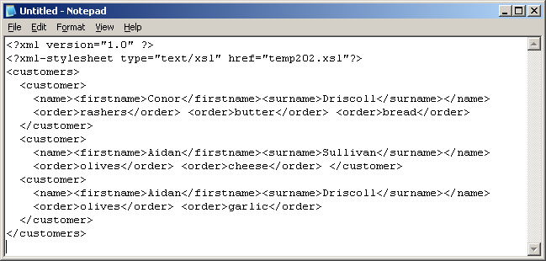
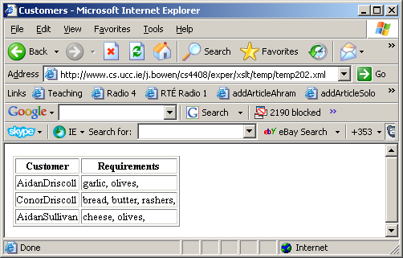
multiple-key sorting inside the xsl:for-each element: names
<?xml version="1.0"?>
<xsl:transform version="1.0" xmlns:xsl="http://www.w3.org/1999/XSL/Transform">
<xsl:template match="/">
<html> <head><title>Customers</title></head> <body> <table rules="all">
<thead><tr><th>Customer</th><th>Requirements</th></tr></thead> <tbody>
<xsl:for-each select="customers/customer">
<xsl:sort select="name/surname"/> <xsl:sort select="name/firstname"/>
<tr><td> <xsl:apply-templates select="name"/> </td><td>
<xsl:for-each select="order"><xsl:sort select="."/><xsl:apply-templates/>, </xsl:for-each>
</td></tr>
</xsl:for-each>
</tbody> </table></body></html></xsl:template>
</xsl:transform>

Slide 10
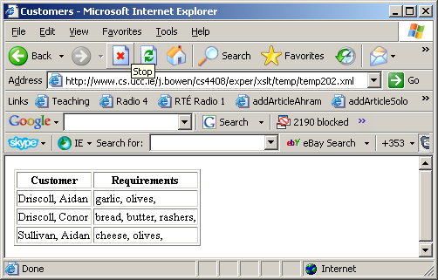
multiple-key sorting again: outputting surname,firstname
<?xml version="1.0"?>
<xsl:transform version="1.0" xmlns:xsl="http://www.w3.org/1999/XSL/Transform">
<xsl:template match="/">
<html> <head><title>Customers</title></head> <body> <table rules="all">
<thead><tr><th>Customer</th><th>Requirements</th></tr></thead> <tbody>
<xsl:for-each select="customers/customer">
<xsl:sort select="name/surname"/> <xsl:sort select="name/firstname"/>
<tr><td> <xsl:apply-templates select="name/surname"/>,
<xsl:apply-templates select="name/firstname"/> </td><td>
<xsl:for-each select="order"><xsl:sort select="."/><xsl:apply-templates/>, </xsl:for-each>
</td></tr>
</xsl:for-each>
</tbody> </table></body></html></xsl:template>
</xsl:transform>

